Slide 1
The Atlantic:A Case Study
Deriving insights from unstructured data

Slide 2
Assumptions
Data though small & time_bound, is representative
Continuous variable are normally distributed
Each visitor_id = independent & non_duplicative (assumption of no multi-device/browser users)

Slide 3
THree Areas of Analytics focus
Publish-Trend
Visit-Trend
Predicting Return
Editorial Impact
-Does Site section matter?
-Is Article publishing time important?
-Does day of week of publishing matter?
User Behavioral Trend
-What is DAU/WAU?
-What hour of day do most users visit?
-What site_sections are users visiting at different times?
Increasing Return %
-When should editorial look to publish content?
-Where should content be published?
-Does it matter when a user visits?

Slide 4






Implementation
How I did it

Slide 5
Insert Raw Data in S3 Bucket
Mutate Data: New col, Type change, calculations
Select valuable inputs for model-fitting in R
Step 1
Step 2
Step 3
Step 4
Step 5
Copy S3 bucket into Redshift schema to prep for data cleansing
Use Superset, to plot & see data/distribution/dashboards

Slide 6
Impact
max growth
Separating the Signal from the Noise

Slide 7
Publisher-Trends
-Article generally published evenly in any week, clustered 9-11AM & 2-4PM in a day
-A user who reads a morning published article is 10% more likely to come back the next day
Insights

Slide 8
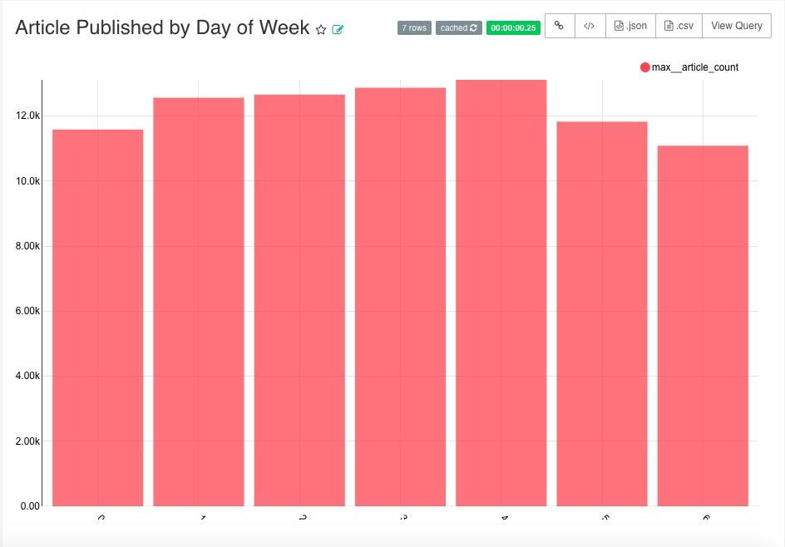
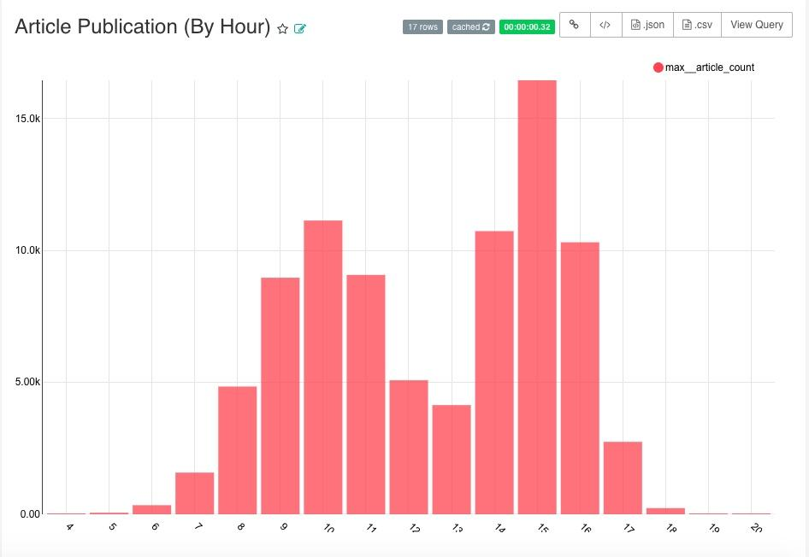
-Article are published evenly (by day of week)
-In a day, Most tend to be published either Morning (9-11 AM) OR Afternoon(2-4PM)

Slide 9
Visit-Trends
-All Visits peak in the first two days of the week, the decline throughout the rest
-Users who visit during the weekday, are 13% more likely to return to site the next day
Insights

Slide 10
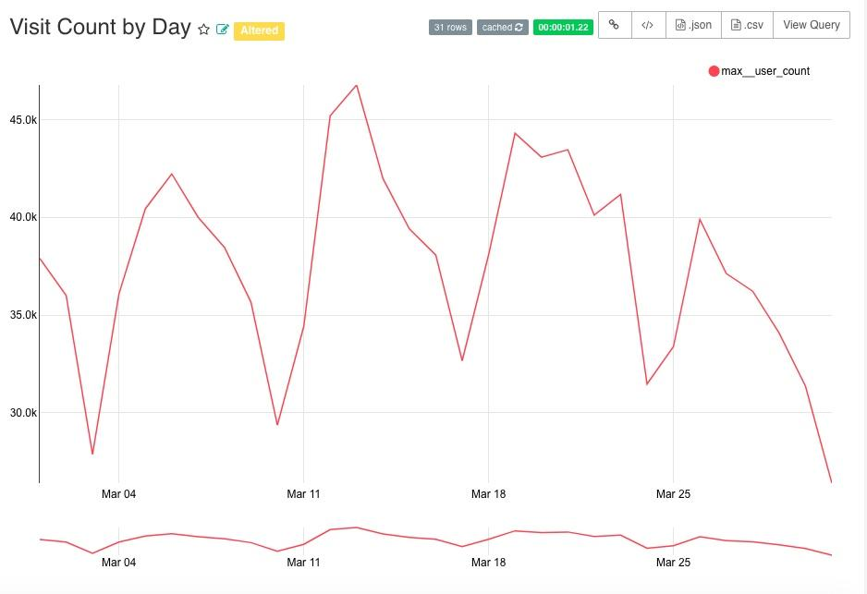
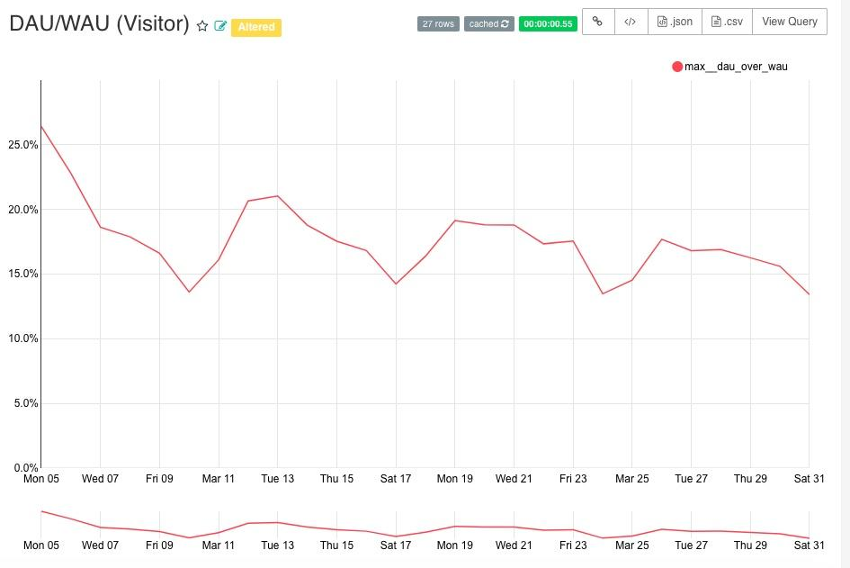
-Visits seem cyclical, peaking Mon & TUes, then a steady drop to SAT Lows
-validated by a consistent DAU/WAU, oscillating between 15% - 20% (weekday vs. Weekend)
-Users are more engaged Beginning of the week!!

Slide 11
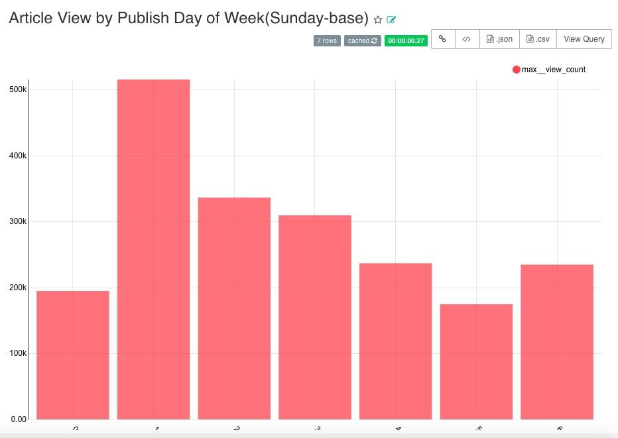
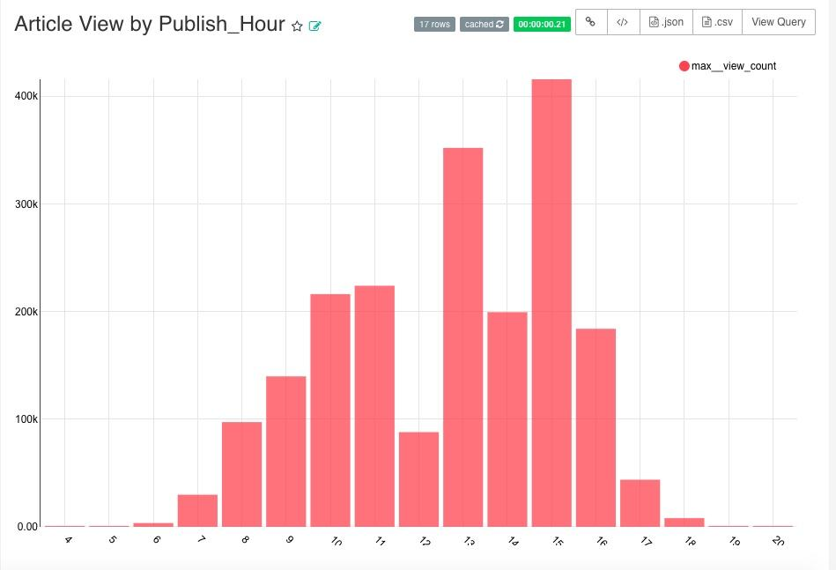
Article View Trends
-Article View by Day of wk mirrors Visit behavior (peak Monday then drops throughout
-By hour of day also matches publishing time, 1PM here is a very surprising peak…...why?

Slide 12
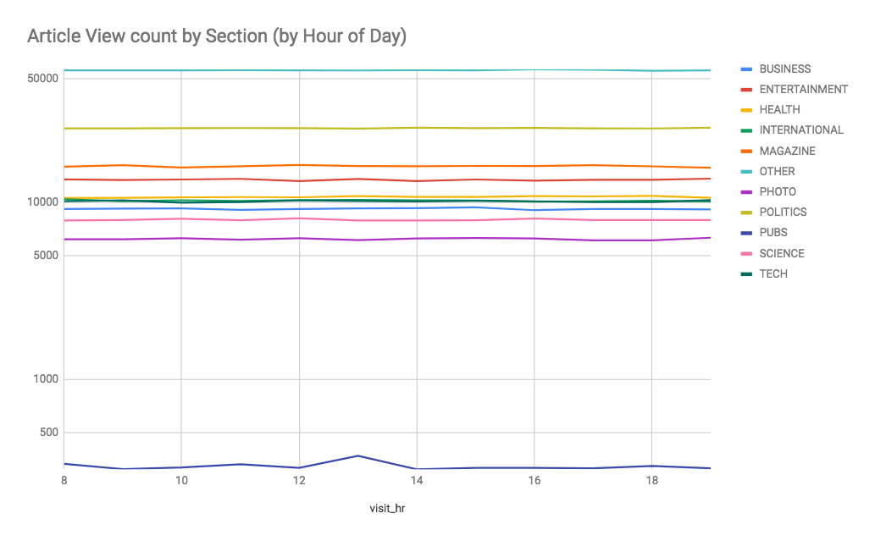
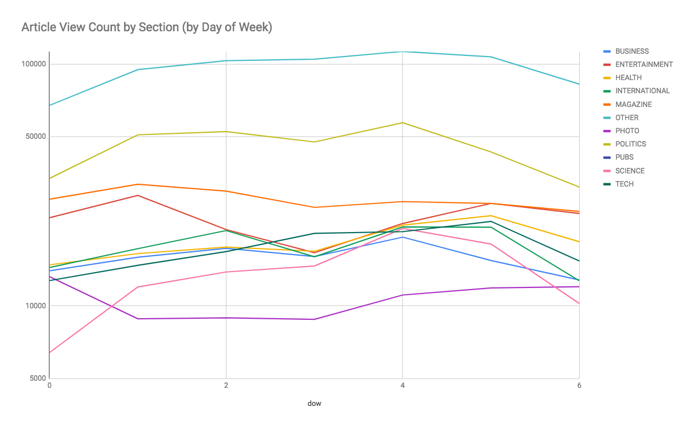
Article View by Site_section
-Do users read certain sections at specific time?
Answer: No, it is very evenly distributed
-Do users read certain sections on specific day?
Answer: Yes, over days of week we observe varying interests in different sections. This would be important to explore if more time.

Slide 13
Visit-Return %
-Users more likely to come back next_day on WEEKDAY (1-4)
-Hour of Day you visit has NO IMPACT on return %
-The timing of when article is published affect user return %
Insights
Notes:
-Confounding Variable:

Slide 14
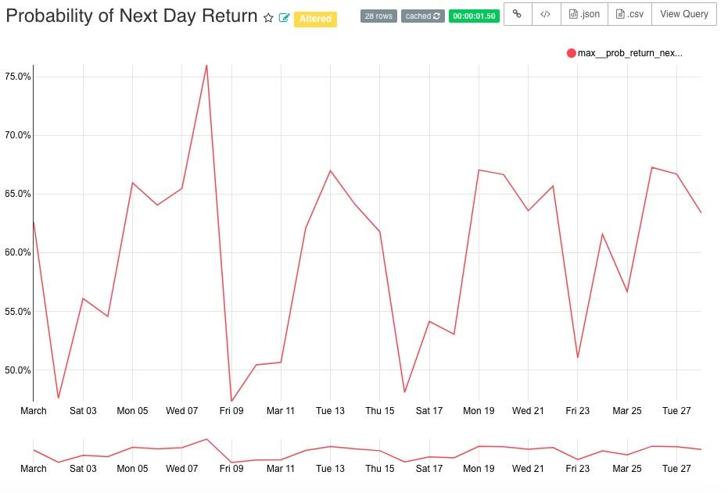
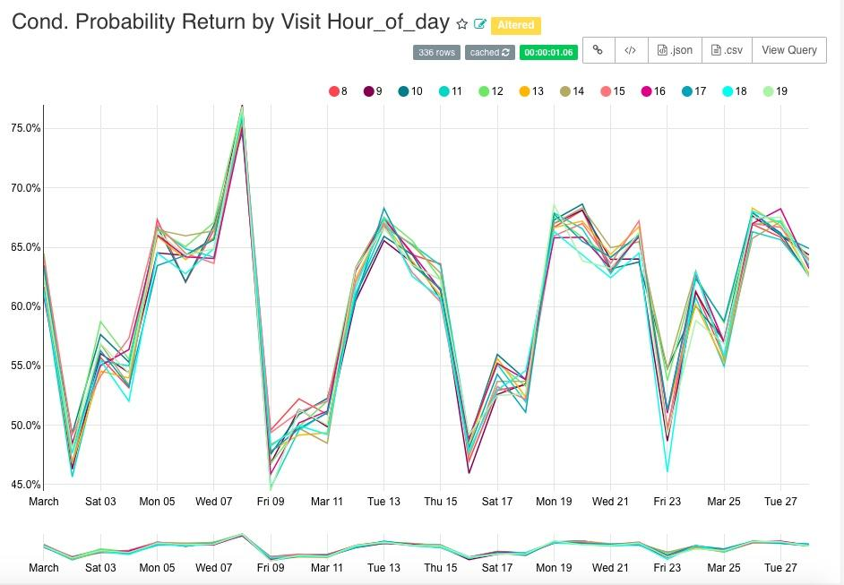
-Similar to Visit, Users more likely to return during weekdays
-Observe that hour of day you visit, has NO impact on your likelihood to return to the site next day

Slide 15
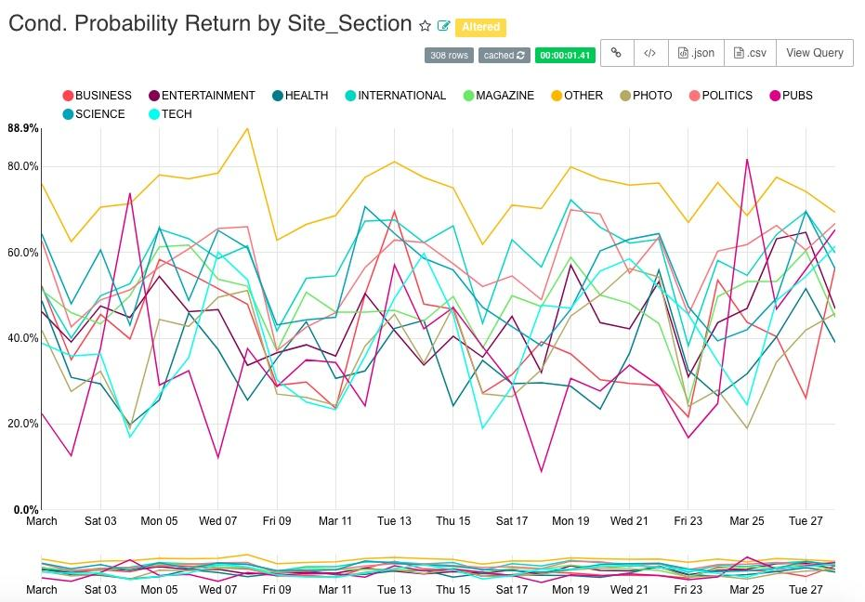
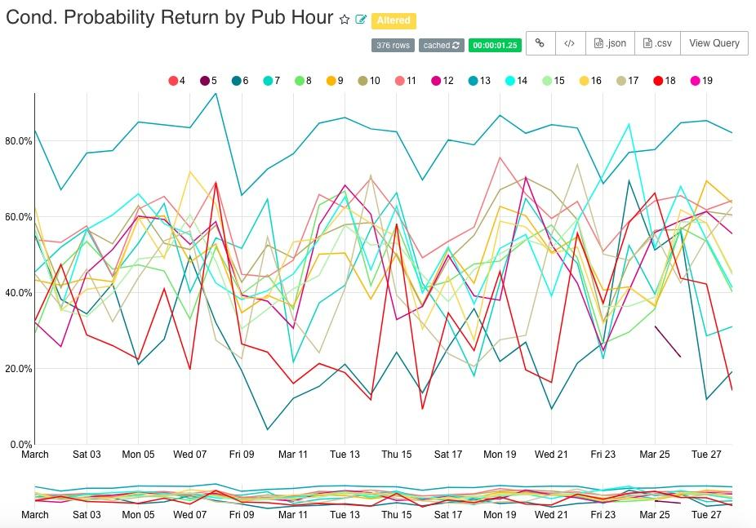
-Site_section presents an interesting story, “Others” performs better in bring people back but is “Blended” 10% of many different section. NEED MORE TIME HERE.
-Content published at 1PM once again surprises, also being very “sticky” in bringing users back

Slide 16
Future DATA Additionsr
Article-Data
User Attributes
Best-Fit Model
Expand Article Info
-Content_type, narrative structure, video….etc.
-Author information would be really helpful
Increase Visitor Info
-Reg_date, reg_brand, channel, primary interest...etc.
-This would allow us to better segment users and cohorts.
Enhance Predictions
-More data -> better cohort ->Quality of Prediction
-Future work focus on section & macro article groups [topic modeling would be interesting here]

